Slide 1
A Data Analytic approach to finding the ideal location for the 1st Moo Burger store in New York

Slide 2
Background
Moo Burger currently have store across all the major cities in Australia.
Our next target is to expand this franchise to America
We need to understand the US market, in particular, New York.

Slide 3
Finding which New York Borough has the most potential
The success of the any business is based on supply and demand.
Assuming the demand is consistent across New York, the supply is analyzed based on population and land area
We want to establish our first Moo Burger at a location with least amount of food venues per capita and per land area

Slide 4
Data acquisition
Food venues are collected using the FourSquare API. The API returns venues in each New York Borough with their categories.
Population and land size data are collected from the US government website

Slide 5
Data Cleaning
Those consider as food venues and included in the calculation are categories with:
Asian Restaurant
Bakery
Breakfast spot
Burger joint
Café / Coffee shop
Caribbean Restaurant
Chinese restaurant
Food truck
French Restaurant
Italian Restaurant / Pizza Shop
Sandwich place
Seafood Restaurant
Wings Joint

Slide 6
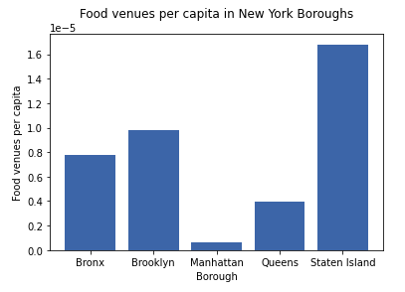

Calculation: $\frac{Number of food venues}{Borough population}$
Manhattan has the least amount of food venues per person
Staten Island has the most amount of food venues per person. This is contributed by the lack of inhabitants in this borough compare to the others

Slide 7
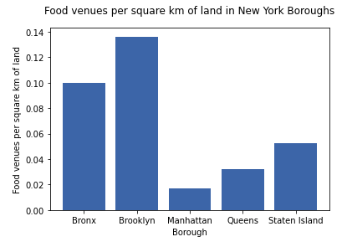

Calculation:
$\frac{Number of food venues}{Borough land area}$
It is the hardest to encounter food venues in Manhattan
It is easiest to find a place to eat in Brooklyn

Slide 8
Conclusion and Future Direction
Manhattan is the perfect location to open the first Moo Burger in New York. It has the least amount of food venues per capita and per square kilometre of land.
Verify food venue data using different database i.e. Google
Use different features (cost) to refine the inclusion of food venues

